Slide 1
Math analysis
Day 28

Slide 2
Objective
Finish your replica of a “Real Life” image that isn’t already pixelated.
Begin to create Space Filling Curves

Slide 3
Saving Your Image:
In Bricklayer Lite Level 3
Save your object as Name_Curves.xml
To Turn In Folder: 13_Space_Filling_Curves_Formative
Save to One Drive and/or Flashdrive!!!

Slide 4
Background on Wunderlich Curves
The Wunderlich curves are a collection of plane-filling curves, similar to the Hilbert and Moore curves. Each Wunderlich curve begins with a seed shape, and each successive iteration translates-rotates-reflects copies of the seed in a 3×3 grid in such a way that the end of one copy is next to the beginning of the next copy.
The first type begins with an S-shape, which winds from the southwest corner of its bounding square to end up in the northeast corner:
http://www.robertdickau.com/wunderlich.html

Slide 5
Goal: Create the Wunderlich Curve to fill a 128x128 screen
The next few slides will act as a preview for what you will be doing today…

Slide 6
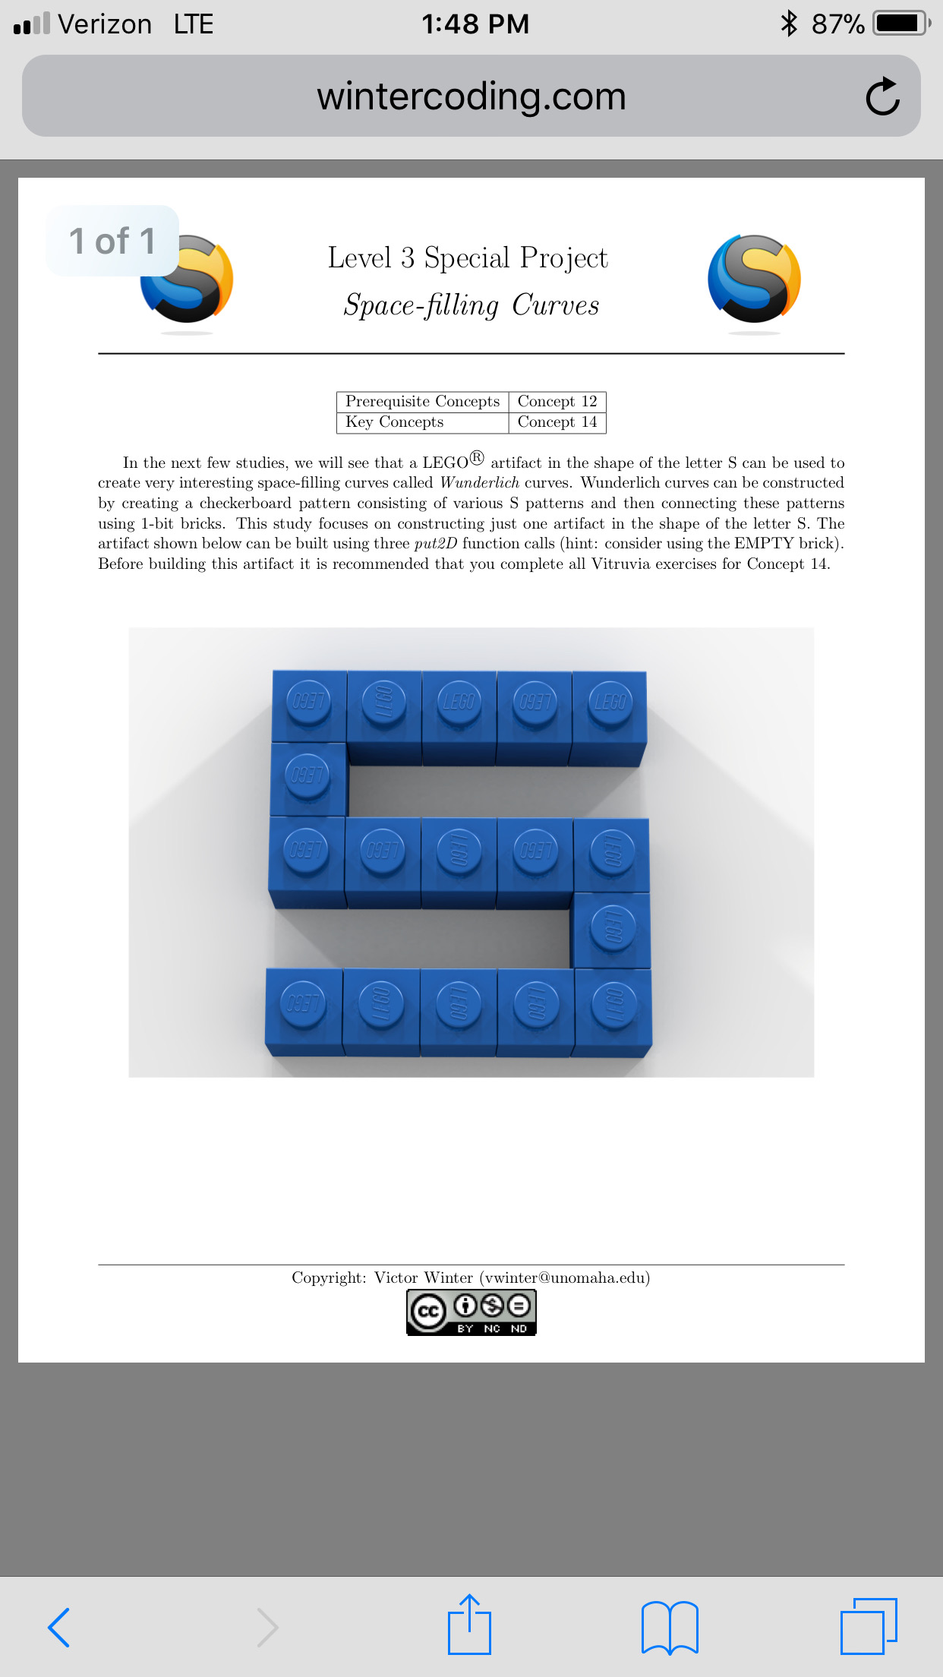
Goal: Start with a single ‘seed’ that will be replicated later on

Slide 7
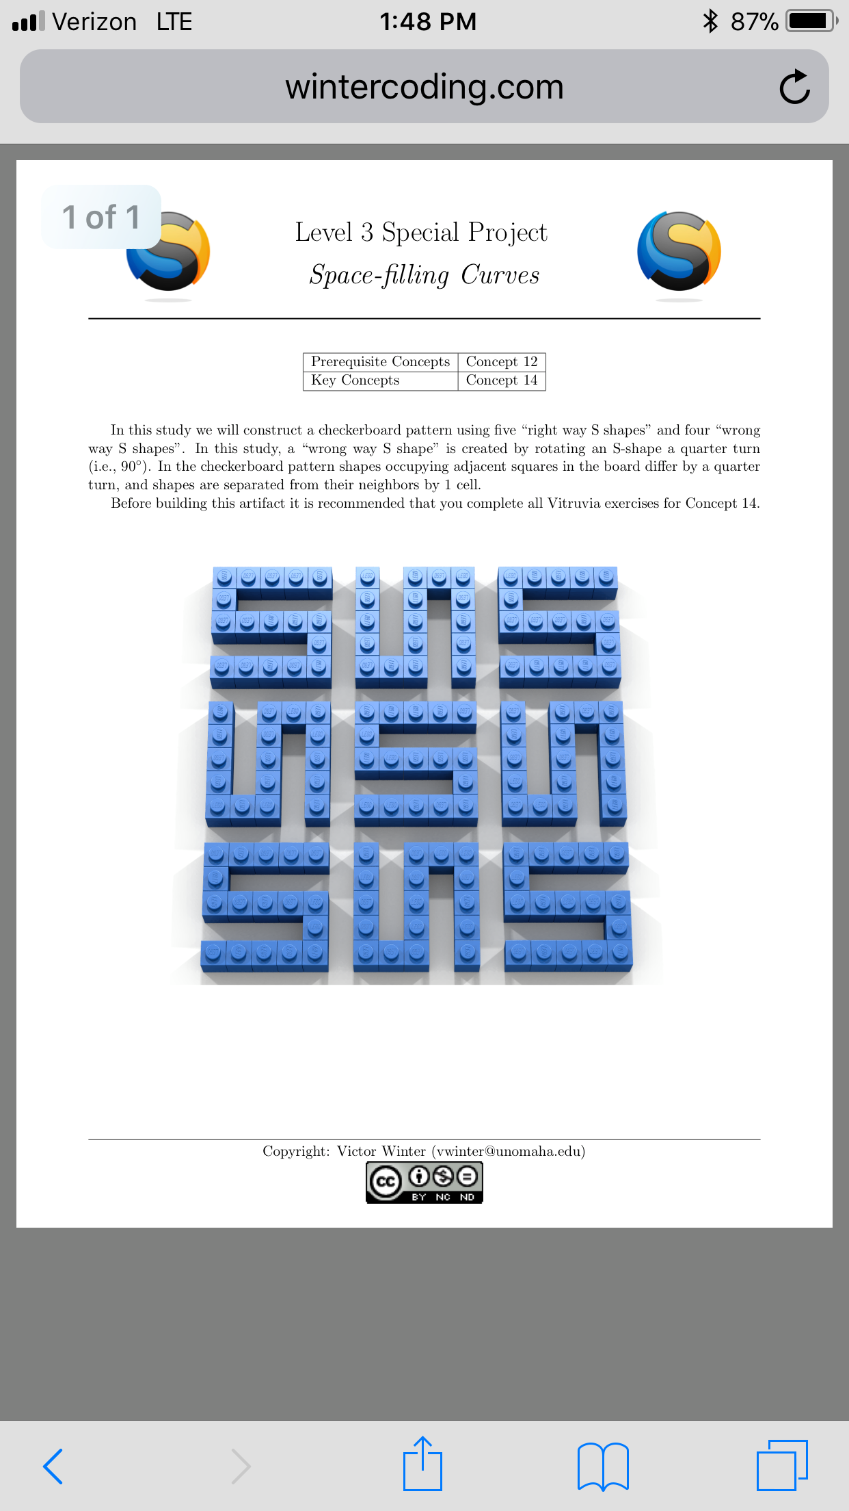
Goal: Be able to the rotations of the ‘seed’ available through alternate function calls or however you see fit.

Slide 8
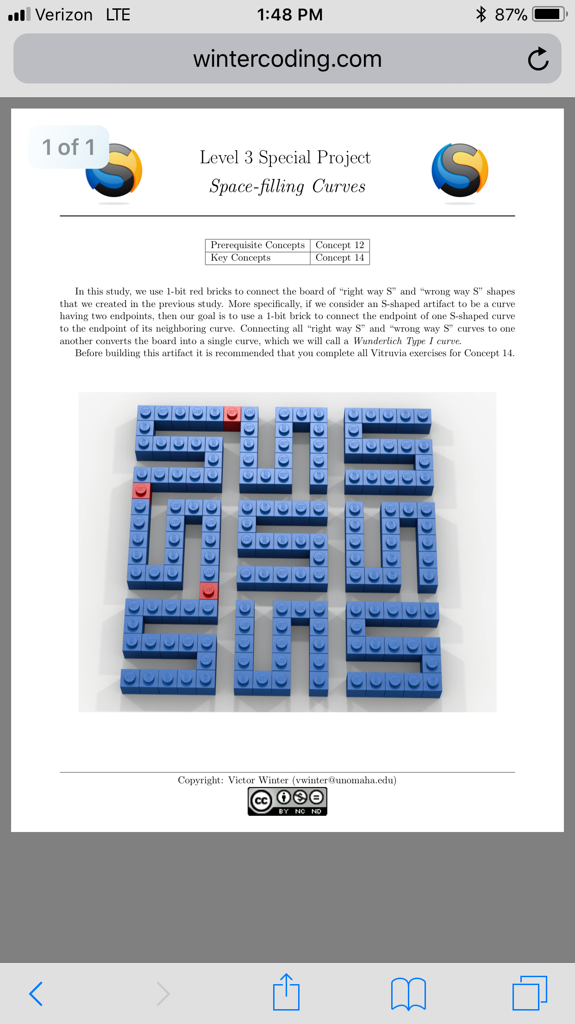
Goal: Connect the ‘seeds’ together in order to form a non stop curve… where the end of one seed touches the start of the next

Slide 9
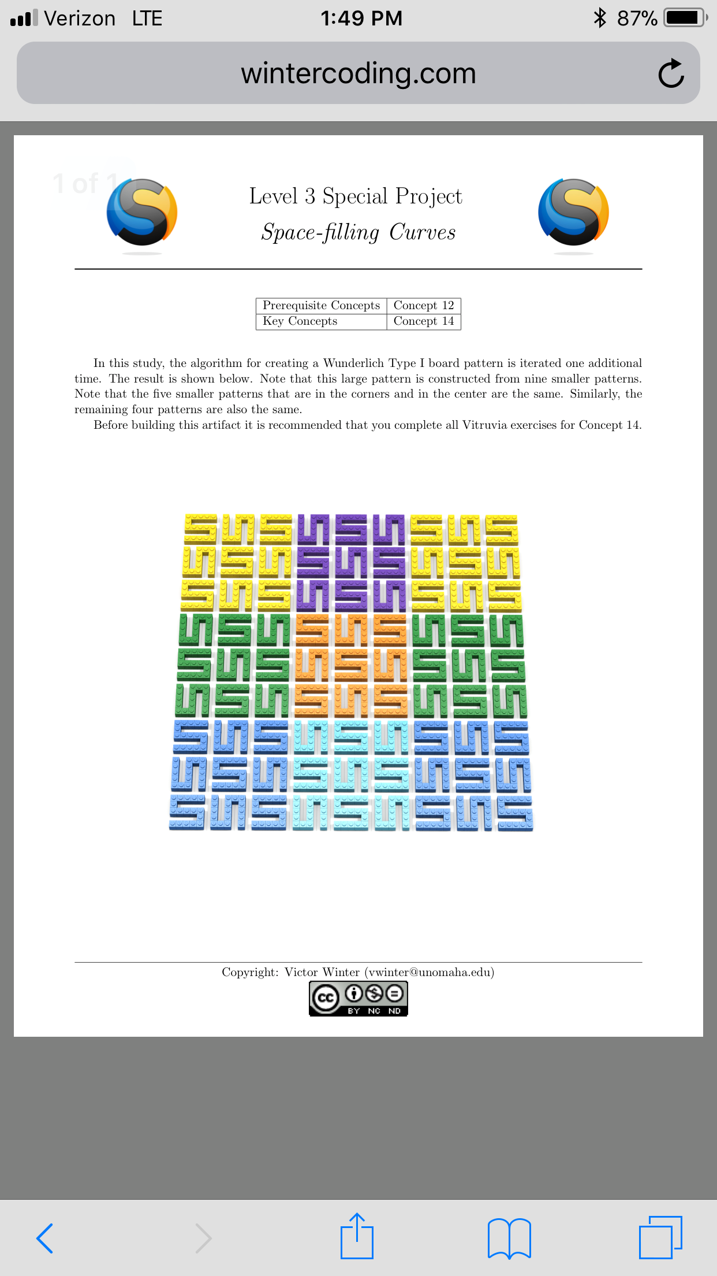
Goal: Repeat this 3x3 pattern to fill in the rest of the screen. Challenge: Alternate the color to separate the 3x3 patterns

Slide 10
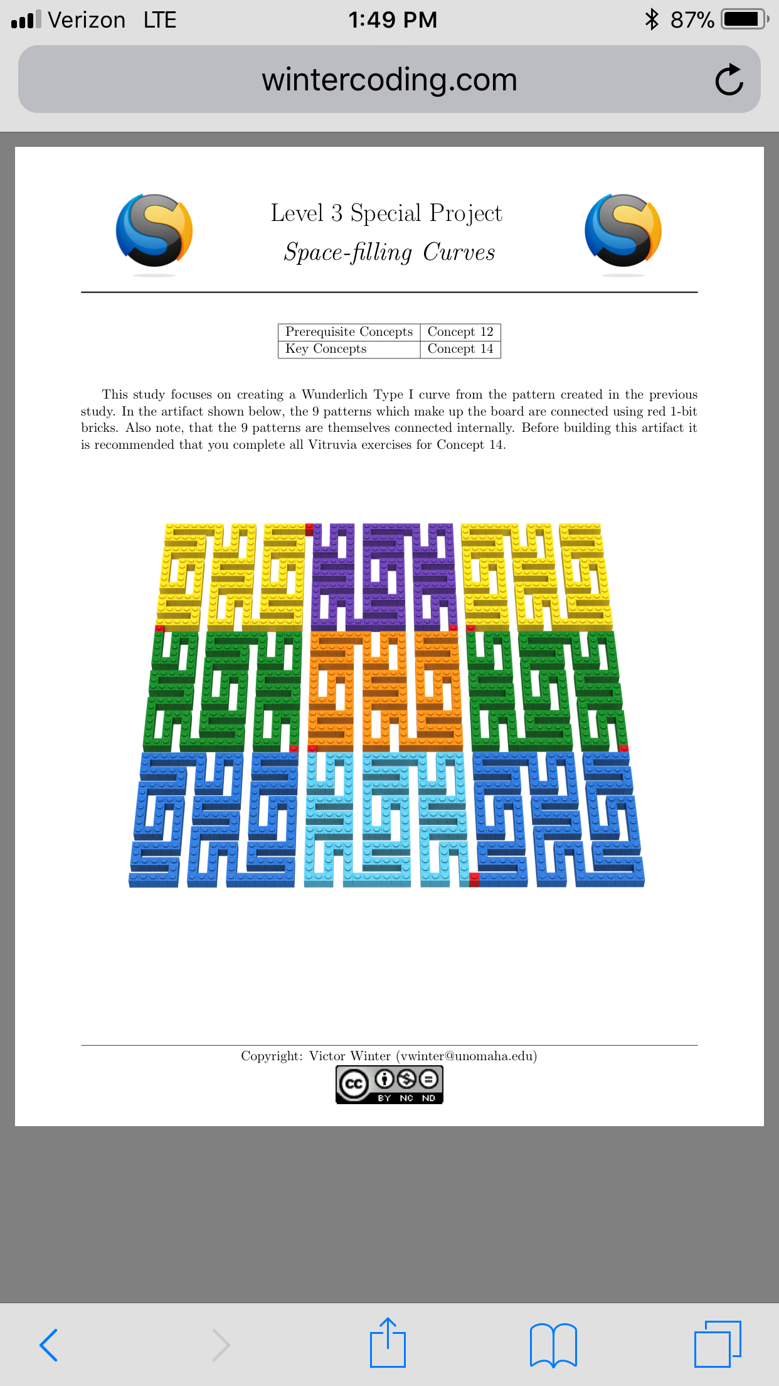
Goal: Connect the 3x3 patterns to form one large curve that fills the entire screen

Slide 11
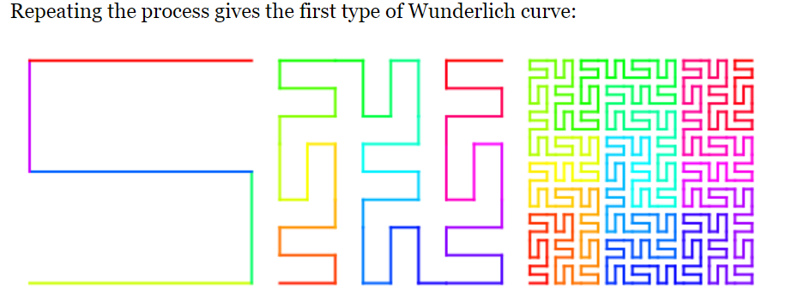
Expand on this Concept:

Slide 12
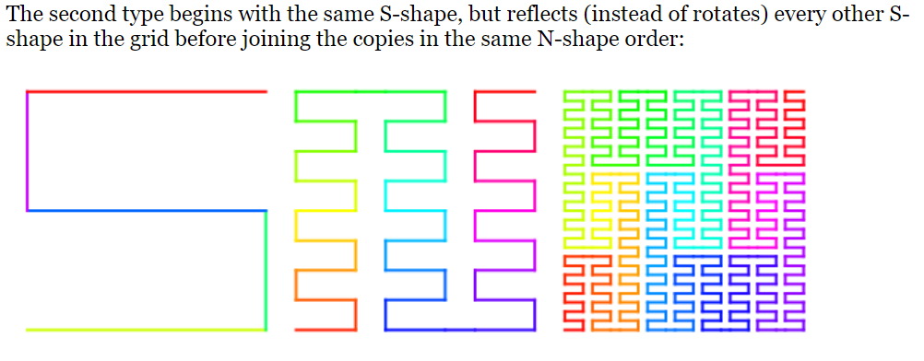
Expand on this Concept:

Slide 13
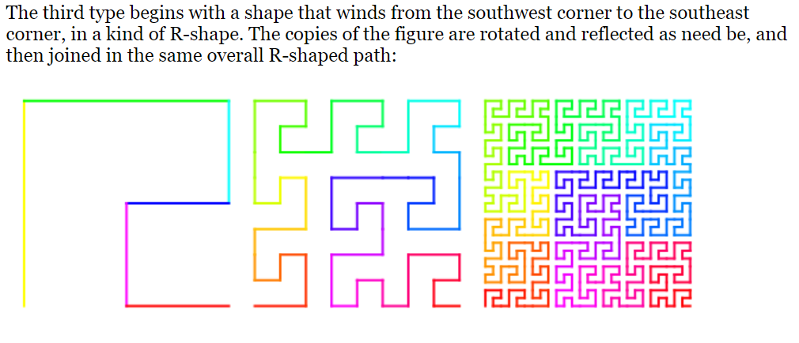
Expand on this Concept:

Slide 14
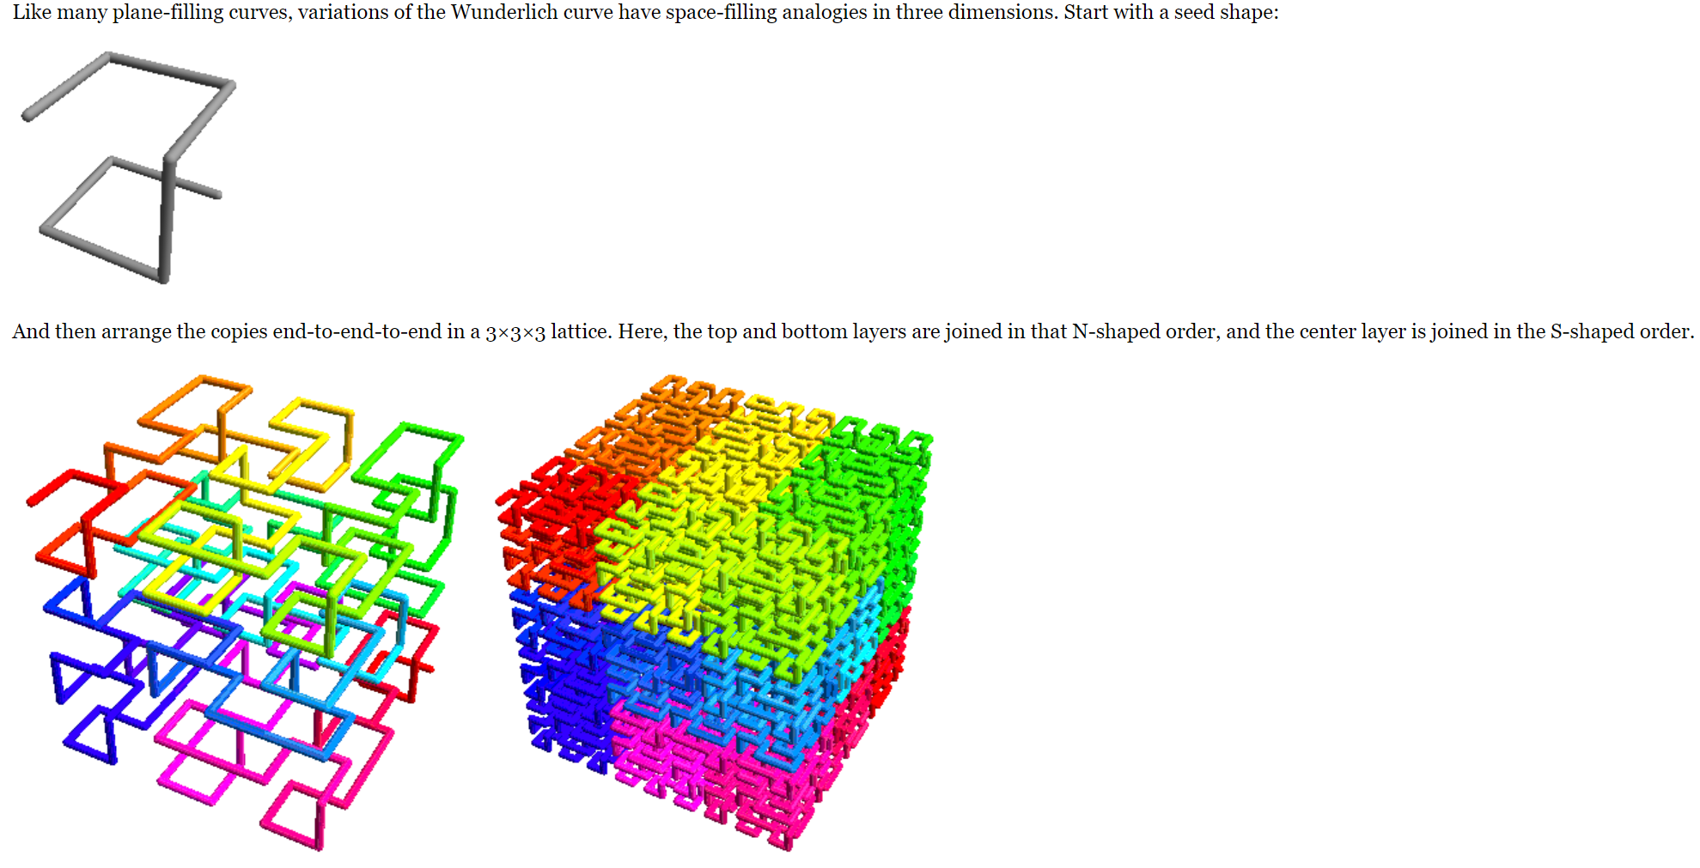
Wunderlich in 3D

Slide 15
Review Saving in Bricklayer Lite to Teams
Change “Filename” make sure it ends with .xml
Click Download XML
Open up Teams
Open the appropriate folder: ______________________
Click “upload” and select your recently downloaded file
Save
*Move the file to your One Drive from your Downloads folder

